Slide 1
PRESAGE-Net (own research)
Ching Chang

Slide 2
Why do I tell the story – a story from BERT to SSL?
Self-supervised Learning
Representation Learning
Leverage Unlabeled Data
Semi-supervised Learning
What really matters to our paper

Slide 3
What really matters to our paper
We’re talking about time series data, not tabular data.
Self-supervised Learning
Representation Learning
Self-prediction
Contrastive Learning
Jerry’s
AutoEncoder
Other
Self-prediction
Method

Slide 4
Tabular Data ≠ Time Series Data
features
features
x1
x2
x3
y
f1
f2
f3
data window
data window
time

Slide 5
Outline
Attention mechanism with matrix factorization
Representation Learning for time series data
NeurIPS 2021 SSL tutorial
SSL for tabular data
SSL for time series data
Predictive method for time series data
Contrastive learning for time series data
Other representation learning for time series data
TCN with encoder-decoder
Final Solution

Slide 6
Attention Mechanism with Matrix Factorization

Slide 7
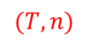
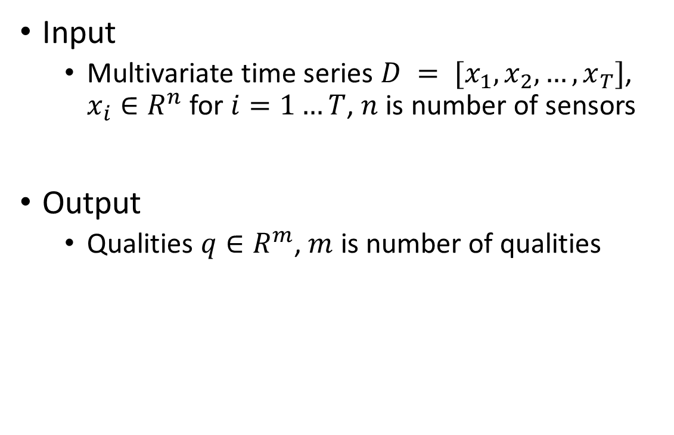
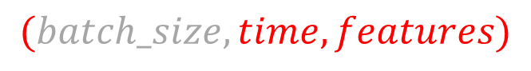
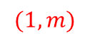
Problem Definition
features
qualities
Input
Multivariate time series $D = [x_{1},x_{2}, …,x_{T}]$, $x_{i}∈R^{n}$ for $i=1…T$, $n$ is number of sensors
Output
Qualities $q∈R^{m}$, $m$ is number of qualities
$$(T, n)$$
$$(1,m)$$
time
$$(batch_size, time, features)$$

Slide 8
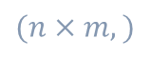
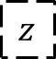

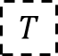
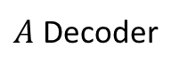
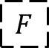
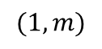
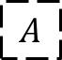
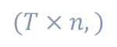
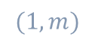
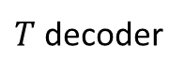
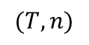
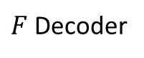
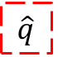
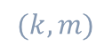
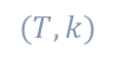
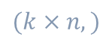
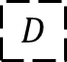
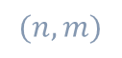
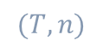
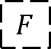
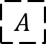
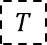
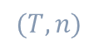
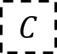
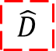
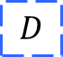
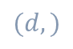
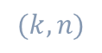
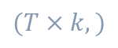

Attention Mechanism with Matrix Factorization
features
qualities
$$(T, n)$$
time
$$(1,m)$$
$T$ decoder
$$T$$
Reshape
$$T$$
$$(T×k,)$$
$$(T,k)$$
$$×$$
$$\hat{D}$$
$$(T,n)$$
$$D$$
Reshape
$$D$$
Encoder
$$z$$
$F$ Decoder
$$F$$
Reshape
$$F$$
$$(T, n)$$
$$(T×n,)$$
$$(d,)$$
$$(k×n,)$$
$$(k,n)$$
$$×$$
$$C$$
w
$$\hat{q}$$
Reshape
$$(k,m)$$
$$(1,m)$$
$A$ Decoder
$$A$$
$$A$$
$$(n×m,)$$
$$(n,m)$$

Slide 9

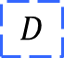




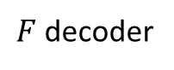
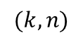
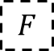
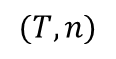
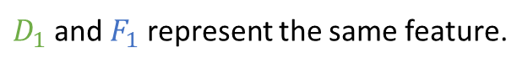

$$D$$
$$F$$
$$D_{1}$$
$$D_{2}$$
…
$$D_{n}$$
$F$ decoder
$$F_{1}$$
$$F_{2}$$
…
$$F_{n}$$
(obtain features)
$$(k, n)$$
$$(T, n)$$
$T$ decoder
$$T$$
Reshape
$$T$$
$D_{1}$ and $F_{1}$ represent the same feature.
$$(T×k,)$$
$$(T,k)$$
$$×$$
$$\hat{D}$$
$$(T,n)$$
$$D$$
Reshape
$$D$$
Encoder
$$z$$
$F$ Decoder
$$F$$
Reshape
$$F$$
$$(T, n)$$
$$(T×n,)$$
$$(d,)$$
$$(k×n,)$$
$$(k,n)$$
$$×$$
$$C$$
w
$$\hat{q}$$
Reshape
$$(k,m)$$
$$(1,m)$$
$A$ Decoder
$$A$$
$$A$$
$$(n×m,)$$
$$(n,m)$$

Slide 10

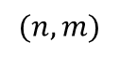
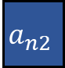
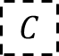
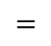
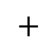
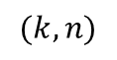
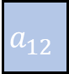

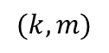
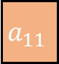






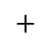


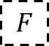















$$a_{11}$$
$$a_{12}$$
…
$$a_{1m}$$
$$F_{1}$$
$$F_{2}$$
…
$$F_{n}$$
$$C_{1}$$
…
…
$$C_{m}$$
$$F$$
$$×$$
$$A$$
$$\text{…}$$
$$\text{…}$$
…
$$\text{…}$$
$$=$$
$$C$$
$$a_{n1}$$
$$a_{n2}$$
…
$$a_{nm}$$
$$(k, n)$$
$$(k,m)$$
$$(n, m)$$
features
qualities
$$C_{1}$$
$$F_{1}$$
…
$$F_{n}$$
$$=$$
$$a_{11}$$
$$∙$$
$$+$$
$$\text{…}$$
$$∙$$
$$+$$
$$a_{n1}$$
$$∙$$
$T$ decoder
$$T$$
Reshape
$$T$$
$$(k,)$$
$$(T×k,)$$
$$(T,k)$$
$a_{ij}=$ how much the feature $F_{i}$ affects the quality $q_{j}$
$$×$$
$$\hat{D}$$
$$(T,n)$$
We use $k$ dimension to represent a quality.
$$D$$
Reshape
$$D$$
Encoder
$$z$$
$F$ Decoder
$$F$$
Reshape
$$F$$
$$(T, n)$$
$$(T×n,)$$
$$(d,)$$
$$(k×n,)$$
$$(k,n)$$
$$×$$
$$C$$
w
$$\hat{q}$$
Reshape
$$(k,m)$$
$$(1,m)$$
$A$ Decoder
$$A$$
$$A$$
$$(n×m,)$$
$$(n,m)$$

Slide 11
NeurIPS 2021 SSL tutorial

Slide 12

Most recent contrastive learning approaches use an extended version of the N-pair loss

Slide 13


InfoNCE
Cross Entropy
# classes = # training samples
InfoNCE
# classes = # negative samples in one single batch
logits

Slide 14

Barlow Twins
Learn to make the cross-correlation matrix between two output features for two distorted version of the same sample close to the identity
Zbontar, Jure, et al. "Barlow twins: Self-supervised learning via redundancy reduction." International Conference on Machine Learning. PMLR, 2021.

Slide 15
Hard Negative Sampling
Hard negative samples are the ones have different labels from the anchor sample, but the embedding features may be very close.
We want to put more focus on hard ones.
Explicit
Upweight the negative sample probability to be proportional to its similarity to the anchor sample
Implicit
Large batch size (in-batch negative samples)

Slide 16


Why does Contrastive Learning Work?
Contrastive learning captures shared information between views.

Slide 17


The InfoMin Principle
Optimal view are the sweet spot where it only encodes useful information for the downstream task.

Slide 18


The InfoMin Principle

Slide 19

Contrastively learned features are more uniform and aligned.

Slide 20
SSL for tabular data

Slide 21
Outline
Paper | Model Name | Conference | Ranking | Year | # citations
Extending the Success of Self- and Semi-supervised Learning to Tabular Domain | VIME | NeurIPS | 2 | 2020 | 63
Self- and Semi-supervised Tabular Learning with COnditional REgularizations | CORE | NeurIPS | 2 | 2021 | 0
Self-Supervised Contrastive Learning using Random Feature Corruption | SCARF | ICLR | 17 | 2022 | 16
Subsetting Features of Tabular Data for Self-Supervised Representation Learning | SubTab | NeurIPS | 2 | 20 | 5

Slide 22
SSL for tabular data
VIME

Slide 23

VIME – Framework for combining 2 SSL

Slide 24

VIME – Self-supervised Learning
Generating corrupted features
Two Pretext Tasks

Slide 25


VIME – Generating Corrupted Features
Masked features must be filled with the same features

Slide 26


VIME – Two Pretext Tasks
Feature vector estimator (everyone is already using it)
We want to reconstruct the original input sample
not the corrupted one
reconstruction loss with $x$
Mask vector estimator (the novel one)
We want to know which features are masked
cross-entropy loss with $m$

Slide 27

VIME – Semi-supervised Learning

Slide 28


VIME – Semi-supervised Learning

Slide 29
VIME = 2 SSL
Data augmentation =
Use several data in one path
AutoEncoder
Decoder

Slide 30
SSL for tabular data
SCARF

Slide 31

SCARF
Basically, it’s the same corruption process in VIME.

Slide 32
SSL for tabular data
SubTab

Slide 33

SubTab

Slide 34
SubTab – Subsetting Features
Subsetting features of tabular data = cropping in image domain
Neighboring subsets can have overlapping regions, defined as a percentage of a dimension of the subset.

Slide 35

SubTab – Reconstruction Loss
A shared decoder is used to reconstruct either the subset fed to the encoder or full tabular data.
(${\tilde{X}}_{1}$ means the reconstruction of whole data built from $D\left(E\left(x_{1}\right)\right)$)

Slide 36

SubTab – Contrastive loss + Distance loss
We feed pairs of projections into 2 losses
Contrastive loss: infoNCE
pos + neg
Distance loss: MSE
pos
All three loss terms (reconstruction loss + contrastive loss + distance) apply a pulling force on positive samples while contrastive loss also applies a push force between positive and negative samples.

Slide 37


SubTab – Training
Contrastive loss on positive pairs is very similar to distance loss on positive pairs:
Contrastive loss on positive pairs wants to maximize the cosine similarity between $z_{a}$ and $z_{b}$.
Distance loss on positive pairs wants to minimize the mse between $z_{a}$ and $z_{b}$.
From CORE?

Slide 38


Difference Between Cosine Similarity and MSE
RMSE is some kind of normalized Euclidean distance.

Slide 39

Difference Between Cosine Similarity and MSE
Cosine similarity is a judgment of orientation and not magnitude:

Slide 40

SubTab – test time

Slide 41


SubTab – adding noise
3 types of noises
Gaussian noise
Swap-noise
randomly sampled from the same column
Zero-out noise
zeroing out randomly selected entries
3 strategies for selecting the features to add noise to:

Slide 42
SSL for time series data

Slide 43
Outline
Paper | Model Name | Conference | Ranking | Year | # citations
Self-supervised Learning for Semi-supervised Time Series Classification | ForeClass | PAKDD | 158 | 2020 | 37
Self-Supervised Time Series Representation Learning by Inter-Intra Relational Reasoning | SelfTime | ICLR (rejected) | X | 2021 | 8
Semi-Supervised Time Series Classification by Temporal Relation Prediction | SemiTime | ICASSP | 13 | 2021 | 11
Self-Supervised Pre-training for Time Series Classification | BERT-DTW | IJCNN | 48 | 2021 | 5
Self-Supervised Contrastive Pre-Training For Time Series via Time-Frequency Consistency | TF-C | NeurIPS | 2 | 2022 | 1

Slide 44
SSL for time series data
(ForeClass) Self-supervised Learning for Semi-supervised Time Series Classification

Slide 45


ForeClass – Framework
The ConvNet model is trained jointly to classify the labeled samples and forecast future series values.
Main: Classification
$$Y_{L}$$
$$X_{L}, X_{U}$$
Class
Fore
Auxiliary: Forecasting
Univariate

Slide 46



ForeClass – Forecasting (self-supervised)
Main: Classification
Input: $X^{F}$
Output: $Y^{F}$
Auxiliary: Forecasting

Slide 47


ForeClass – Classification (supervised)
Main: Classification
Input: $X^{L}$
Output: $Y^{L}$
Auxiliary: Forecasting

Slide 48


ForeClass – Framework
Shared weights!
(Conv1D can accept different size of input)
Input: $X^{L}$
Main: Classification
Auxiliary: Forecasting
Input: $X^{F}$

Slide 49
SSL for time series data
(SelfTime) Self-Supervised Time Series Representation Learning by Inter-Intra Relational Reasoning

Slide 50

SelfTime – Relation Reasoning
Univariate
Inter-sample: positive pair (from the same sample’s augmentation) + negative pair (from different samples’ augmentation)
Binary Classification
Intra-temporal: multi-class pairs (from two time pieces)
Multi-class Classification

Slide 51

SelfTime – Framework (2 pretext tasks)
shared
separate
4-layer Conv1D with ReLU and BN
2-layer MLP with 256 hidden-dimensions

Slide 52



SelfTime – Inter-sample
Binary Classification
anchor
vector concatenation operation

Slide 53



SelfTime – Intra-sample
anchor
Multi-class Classification

Slide 54
SSL for time series data
(SemiTime) Semi-Supervised Time Series Classification by Temporal Relation Prediction

Slide 55

SemiTime – Temporal Relation Prediction
Univariate

Slide 56

SemiTime – Framework (1 pretext task)
separate
shared
Downstream task
Pretext task
4-layer Conv1D with ReLU and BN
Linear layer,
2-layer MLP with 256 hidden-dimensions

Slide 57
SemiTime – Downstream task (main task)
Downstream task
One sample at a time
Pretext task

Slide 58

SemiTime – Pretext task
Downstream task
Pretext task
Use “concat” just like SelfTime

Slide 59
SSL for time series data
(BERT-DTW) Self-Supervised Pre-training for Time Series Classification

Slide 60

BERT-DTW – Framework

Slide 61
BERT-DTW – Encoder
Stacking 4 self-attention blocks
The original linear layer is replaced by a series of convolution layers (conv1d) with different kernel sizes
H = 12
kernel_size = {3, 5, 7, 9, 11, 13, 15, 17, 19, 21, 23, 25}
Solve the time series tokenization problem

Slide 62

BERT-DTW – First Pretext Task: Denoising
Adding noise to the sub-series of the time series (good)
Adding noise to several moments in the time series (bad)

Slide 63



BERT-DTW – Second Pretext Task: Similarity Discrimination Based on DTW (SDBD)

Slide 64
SSL for time series data
(TC-F) Self-Supervised Contrastive Pre-Training For Time Series via Time-Frequency Consistency

Slide 65
Dataset

Slide 66




Open dataset with reproducibility
Three open dataset, only one of these is usable
The first one is time series regression
The last two are time series forecasting
Theses are all time series forecasting dataset!
(We can use all this data to our experiments)

Slide 68
Reference

Slide 69
Q1 journals
Journal Name | NYCU Standard | Impact Factor from IEEE | 2-year Impact Factor | H index
(ACM) TIST | B |  | 9.904 | 65
(IEEE) TNNLS | A | 14.255 | 10.472 | 221
IEEE Transactions on Industrial Informatics | A | 11.648 | 12.029 | 151
IEEE Transactions on Industry Applications | - | 4.079 | 5.212 | 206
IEEE Transactions on Industrial Electronics | A | 8.162 | 9.051 | 304
Impact Factor: the number of citations that articles published in that journal receive over time
H-index: the number of papers (h) published in a journal that have been cited at least h times.

Slide 70



Dimensions of time series in different libraries
TensorFlow’s Conv1D:
TensorFlow
(batch_size, time, features)
PyTorch
(batch_size, features, time)
Darts (not that important)
(features, time, batch_size)
PyTorch’s Conv1d:
PyTorch’s BatchNorm1d:

Slide 71

Others
KAIS
NYCU: Top-B
IJCAI
Ranking: 14
NYCU: Top-A
(Last year) Full paper submission deadline: January 14, 2022
All paper submissions to the main track must have a maximum of six pages, plus at most one for references/acknowledgements/ethics statement.

Slide 72
TCN with Encoder-Decoder architecture
(DeepTCN) Probabilistic Forecasting with Temporal Convolutional Neural Network
Neurocomputing (Q1) 2019, #citations = 116
Time Series Encodings with Temporal Convolutional Networks
BIOMA 2020, #citations = 12
Temporal convolutional autoencoder for unsupervised anomaly detection in time series
Applied Soft Computing (Q1) 2021 , #citations = 14

Slide 73
To Do List
Done
Dataset and dataloader for MCMP dataset
DNN (failed to run with pytorch-lightning)
To do
PRESAGE-Net (with TCN encoder-decoder architecture)
Other methods
CNN, LSTM, LSTM-Autoencoder
Darts (Nbeats, TFT, NHiTs)
Other 2 datasets

Slide 74
Solution To Do List

